Slide 1
BTEC LEVEL 2 TECH AWARD
Promotion and Finance for Enterprise

Slide 2
LEARNING AIM B- FINANCIAL RECORDS
Learners will complete, interpret and check the information on financial documents and statements.

Slide 3
TITLE: B6 STATEMENT OF FINANCIAL POSITION
DATE :
Objectives:
- To be able to explain the main components of a statement of financial position
- To be able to interpret and analyse data (ratios and figures) on a statement of financial position
Starter: Write a list of things that a business might own and owe

Slide 4
Starter: Write a list of things that a business might own and owe
Own
Owe

Slide 5
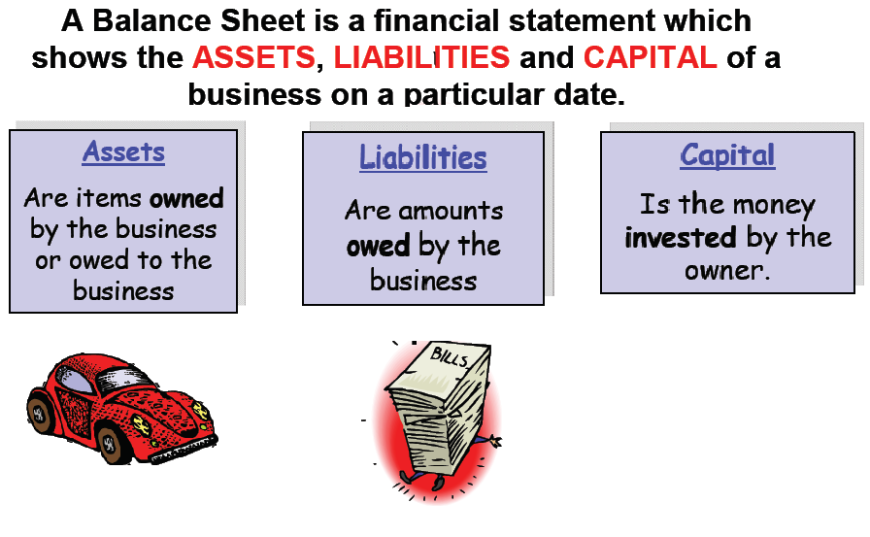

Statement of Financial Position
What’s included in the balance sheet?

Slide 6
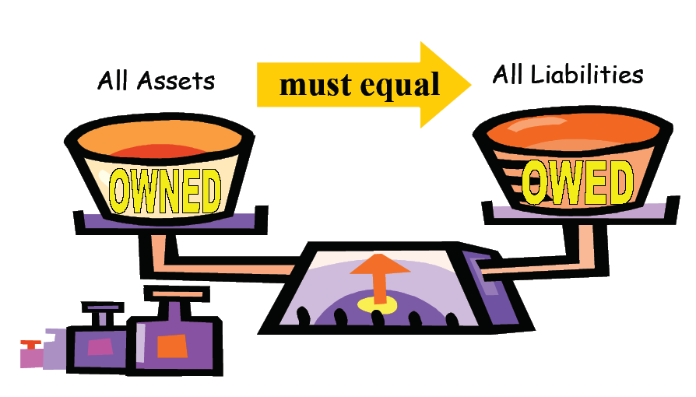
The key rule

Slide 7
Sections of the SoFP
Assets
Liabilities
Fixed Assets
  Cost a lot of money
  Are kept in the business a long time e.g. Equipment or Buildings
Current Assets
Get used up quickly and replaced e.g. stock
  Can be sold quickly to raise cash
Current Liabilities
  Money owed by the business eg to suppliers (creditors)
  Need to be paid within 1 year
Long Term Liabilities
  Long term loans e.g. mortgage
  Amounts that are to be paid back in more than 1 years time

Slide 8
STATEMENT OF FINANCIAL POSITION
The statement of financial position is a record of a business assets and liabilities.
Like a P/L account it is a record of what has happened.
Qs What are assets?
Qs What are liabilities
Assets
These are what the business owns
Liabilities
This is what the business owes.

Slide 9
STATEMENT OF FINANCIAL POSITION
The Top Half
This shows what the business has done with its money.
It is called NET ASSETS. (This is what the business is worth)
The Bottom Half
This shows where all the money that the business has used came from.
It usually comes from shareholders, retained profit and loans.
It is often called CAPITAL EMPLOYED.

Slide 10
STATEMENT OF FINANCIAL POSITION
Working capital pays the day to day running expenses.
It is what the business owns which is either cash or can be turned into cash.
It is calculated using the following sum:
Current assets
MINUS
Current Liabilities

Slide 11
On the SoFP:
Net Assets Employed = Capital Employed
The top and the bottom must be equal … why?
Fixed Assets
+
Working Capital
(CA – CL)
Shareholders
Funds
+
Retained Profit
+
Long Term Loans

Slide 12
This the top part of the SoFP sheet
statement of financial positionFor Morgan’s Ladders 31st March 2012
£000 £000
Fixed Assets
Premises 80
Machinery 40
Vehicles 30
Current Assets
Stock 5
Debtors 12
Cash 3
Current Liabilities
Creditors 15
Working Capital
Net Assets Employed
Add up Fixed Assets
150
Add up Current Assets
Working Capital = Current Assets – Current Liabilities
20
Fixed Assets + Working Capital
5
155

Slide 13
This is the 2nd part of the statement of financial position
Financed By:
£000 £000
Share Capital 90
Retained Profit 35
Long Term Liabilities
Bank Loan 30
130
Add all these figures
together
Capital Employed
155

Slide 14
 | £ | £
Fixed Assets
Premises |  | 60,000
Equipment |  | 14,000
Current Assets
Stocks | 2,000
Debtors | 5,000
Cash at Bank | 5,000
Current Liabilities
Overdraft | 3,000
Creditors | 3,000
Working Capital
Net Assets
Financed by:
Owners Capital |  | 40,000
Long Term Liability (Loan) |  | 40,000
Capital Employed
Lets complete a balance sheet

Slide 15
 | £ | £
Fixed Assets
Premises |  | 60,000
Equipment |  | 14,000
Current Assets
Stocks | 2,000
Debtors | 5,000
Cash at Bank | 5,000
Current Liabilities
Overdraft | 3,000
Creditors | 3,000
Working Capital
Net Assets
Financed by:
Owners Capital |  | 40,000
Long Term Liability (Loan) |  | 40,000
Capital Employed
Example 2

Slide 16
 | £ | £
Fixed Assets
Premises |  | 60,000
Equipment |  | 14,000
 |  | 74,000
Current Assets
Stocks | 2,000
Debtors | 5,000
Cash at Bank | 5,000
 |  | 12,000
Current Liabilities
Overdraft | 3,000
Creditors | 3,000
 |  | 6,000
Working Capital |  | 6,000
Net Assets |  | 80,000
Financed by:
Owners Capital |  | 40,000
Long Term Liability (Loan) |  | 40,000
Capital Employed |  | 80,000

Slide 17
SOFP ACTIVITIES…
Complete the SoFP activities found in the shared area. You may work together with your shoulder partner.

Slide 18

PLENARY
Share 3 things you have learned today with your shoulder partner.

